Slide 1

KAPASA MAKASA UNIVERSITY
Research Methods (AA400/ AA300)
Lecture I – Introduction to Research
Mrs Sarah Ng’andwe Tembo
Dept of Agric and Aquatic sciences
March 2026

Slide 2
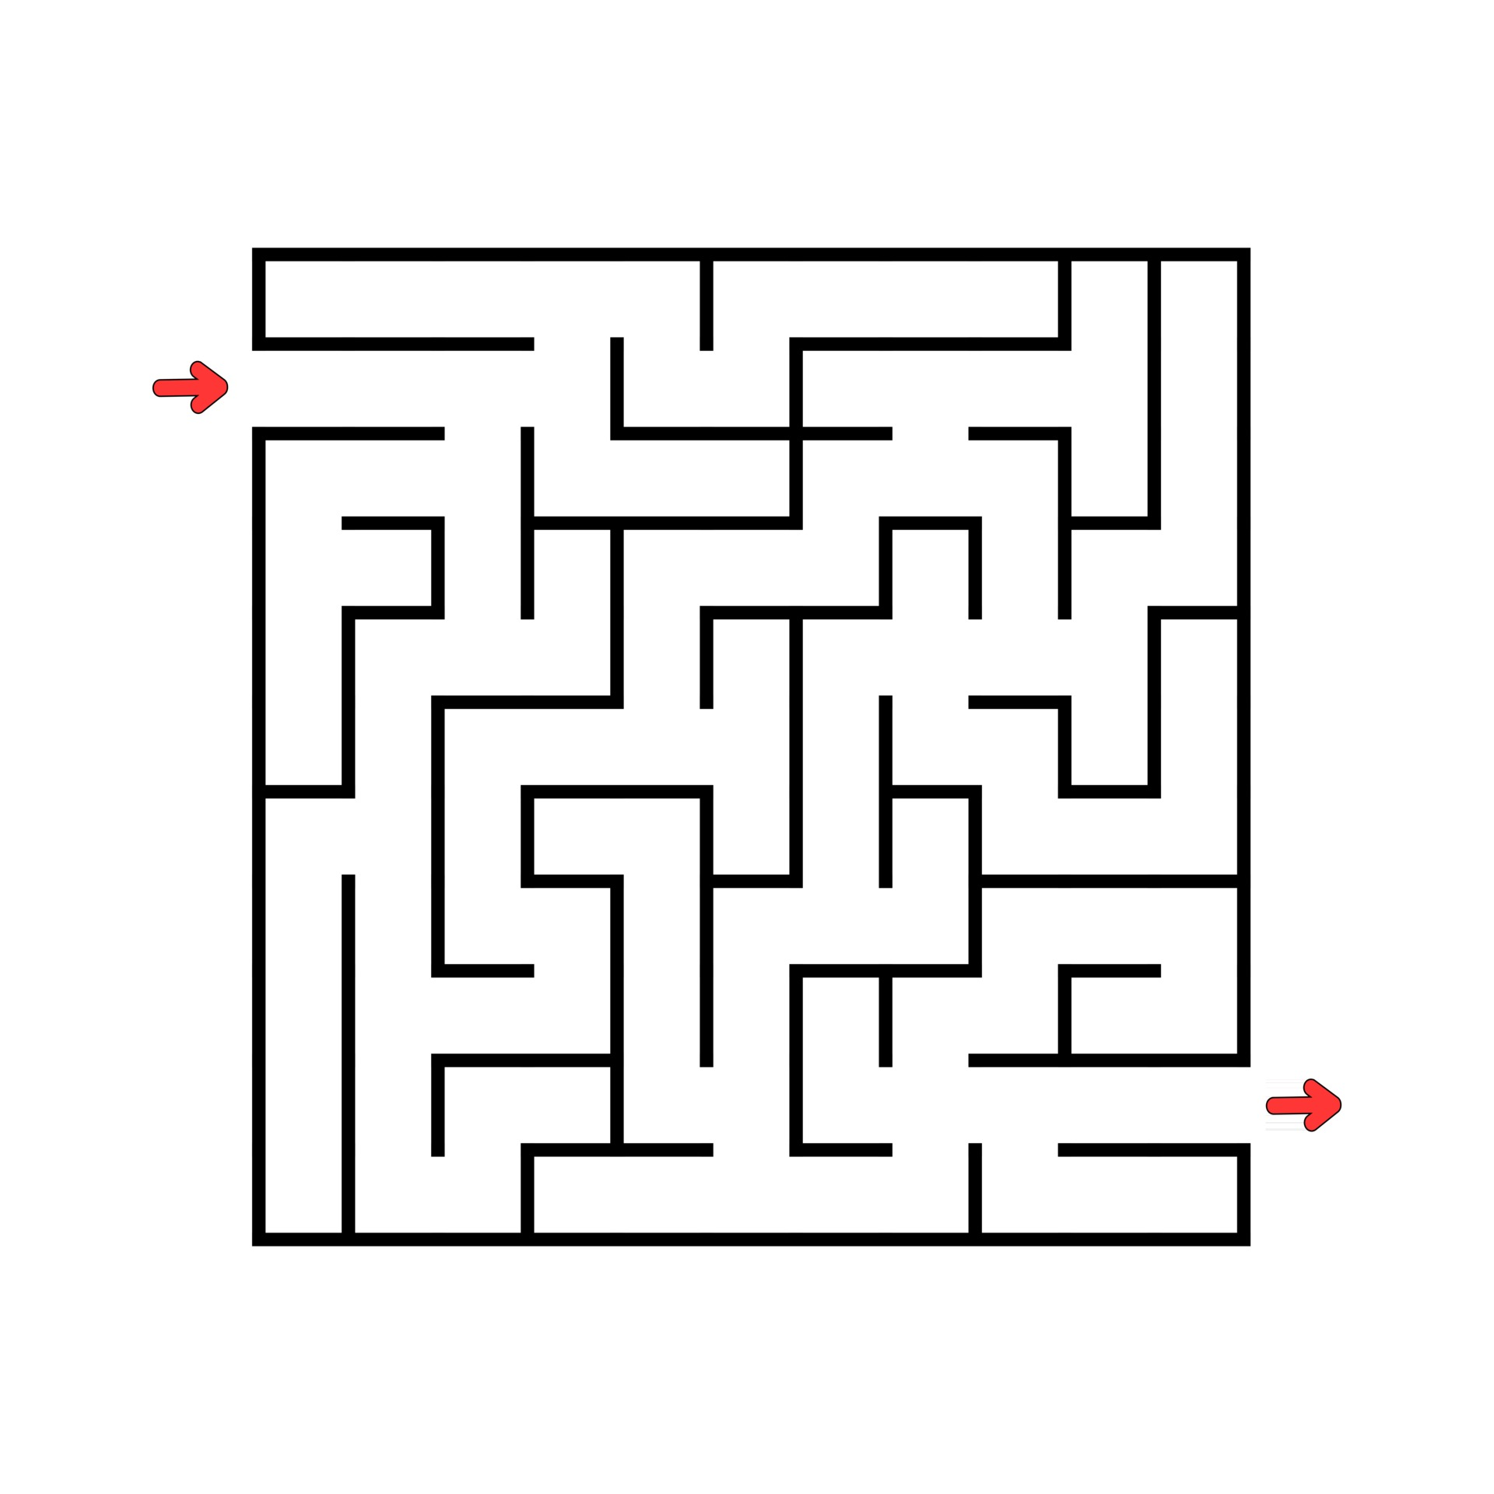
Research Path
Research: a path through the maze
Tony Greenfield and Tom Bourner
‘Life is a maze in which we take the wrong turning before we have learned to walk.’ Cyril Connolly (1944)
Research may seem, at first sight , like a mysterious world full of very clever people, remote from the rest of us, talking in strange languages about weird subjects

Slide 3
Research Path Cont’
There are many paths through the research maze.
Some paths will pose more difficulties than others, present more limitations, and take you down fruitless side tracks; others will present greater insight and surprises
Research is about solving problems: overcoming the obstacles between the first statement of a problem and its solution

Slide 4
Research Path Cont’
Many research projects arise from a study of current thinking in a field. The research project follows from identifying a gap in the literature
  Identify gaps in current knowledge
  Carry on from where others have already reached (reviewing the field allows you to build on the platform of existing knowledge and ideas)
  Identify other people working in the same and related fields (they provide you with a researcher network, which is a valuable resource indeed)
  Increase your breadth of knowledge of the area in which your subject is located

Slide 5
What is Research?
Research is a systematic, organized, and objective process of investigating a problem in order to generate new knowledge or validate existing knowledge
Research begins with an unanswered question in the mind of the researcher
Research Requires a plan
Research deals with the main problem through appropriate subproblems

Slide 6
Importance of research
Expands knowledge and contributes to theory development
Provides solutions to practical problems
Supports evidence-based decision-making
Tests and improves existing practices
Promotes innovation and technological advancement
Informs policy and development planning
For example, agricultural research has contributed to improved crop varieties, soil fertility management techniques, and climate-smart agriculture strategies

Slide 7
Characteristics of a good research topic
Access – difficult or easy or impractical?
Achievable in the time available – time normally underestimated, delays etc
Symmetry of potential outcomes – results valuable whatever outcome
Student capabilities and interest – strong capabilities, identify them and then work towards them

Slide 8
Characteristics of a good research topic
Financial support – an obvious bottleneck
Value and scope of the research – demonstrate research competence or problem-solving ability, whether to add to body of knowledge, national interest problem issues and their practical application

Slide 9
Definition of Science
Is an interconnected series of concepts and conceptual schemes that have developed as a result of experimentation and observations (Conant, 1951)
Sax (1968) viewed science both as a method and an attitude
  As a method: empirical sciences consist of controlled observations……observations are controlled by eliminating or reducing the effects of irrelevant or extraneous variables by means of apparatus, tests, examinations, instruments or specialised techniques

Slide 10
Definition of Science Cont’
  As an attitude: Science consists of a willingness to examine and, if need be, to modify or repudiate one’s own beliefs, ideas, or methods as new or more reliable evidence is obtained. The attitude is one that encourages the scientist to control and reduce biases, to be as precise as possible, to verify or disprove his beliefs empirically, and to organise empirically obtained data into a meaningful body of theoretical knowledge

Slide 11
Assumptions of Science
Sjoberg and Nett (1968) described a minimum set of assumptions that underlie scientific investigation
  There is order in the natural world
  Knowledge is superior to ignorance
  There is a communication tie between the scientist and external reality
  There are cause-and-effect relationships within the physical and the social orders
  The scientist is motivated to acquire scientific knowledge by a desire to improve society
  The scientist as an observer, is a reliable ‘’instrument’’ for scientific activities

Slide 12
Assumptions of Science Cont’
  The social conditions necessary for scientific activity can be sustained
Aims of Science
There are four major aims of science:
  Description
  Explanation
  Prediction
  Progress

Slide 13
Aims of Science Cont’
Explanation:
  After obtaining an accurate description, scientists need to answer the question, why? An explanation gives significance and meaning to the description by telling the conditions under which things and events come about, what causes them, and the previously verified principles or laws that determine their occurrences

Slide 14
Aims of Science Cont’
Prediction:
  Scientists are not content to describe and explain phenomena; they want to take what they know and predict future events under certain conditions
  They speak in probabilities rather than absolute predictions
  Progress:
    Scientific work is often undertaken to influence the future in some positive way
    Its objective is change – remedial or developmental action that will improve the quality of life

Slide 15
Language of scientific research
The science or study of methods of research, otherwise called research methodology, has its own language and key words.
It is appropriate at this stage to briefly highlight the meaning of words that we will continue to encounter as we study and apply the scientific method.
These include; population (or universe), sample, subject, parameter, statistic, concept, variable, hypothesis and theory.

Slide 16
Definition of common terms
Population (or universe): The entire group of people, events, institutions, issues and countries that is the target or subject of investigation. Example: All maize farms in Zambia.
Sample: Any sub-set or sub-group of the population. Example: Maize farms in Muchinga Province.
A subject: Is a single member of a sample. Example: One maize farm in Chinsali.
A parameter: A measurable attribute of the population. Example: Average maize yield per hectare across all farms in Zambia.
A statistic: A measurable attribute of the sample. Example: Average maize yield per hectare from farms in Muchinga Province.
A Concept: Is an abstraction based on characteristics of perceived reality. It is a word or general notion that expresses generalizations from particulars. For instance, “weight” is a concept that expresses numerous observations of the extent to which things are more or less heavy.
Statistics: The science of collecting, organizing, analyzing, and interpreting data, with the objective of making inferences (conclusions) about a population based on information from a sample.

Slide 17
Definition of common terms cont”
Variable: A characteristic that can take different values among subjects. Example: The weight of a fish, the height of a maize plant, or the age of a cow.
  Independent variable: The factor you manipulate (e.g., type of fertilizer)
  Dependent variable: The outcome you measure (e.g., maize yield).
Hypothesis: A tentative statement predicting a relationship between variables. Example: “Using fertilizer X increases maize yield compared to fertilizer Y.
Theory: A well-established explanation supported by repeated evidence and testing. Example: The theory of natural selection in biology, or the theory that improved soil fertility leads to higher crop yields.

Slide 18
Objectives of Research
To discover new facts
To verify and test important facts
To analyse an event or process or phenomenon to identify the cause and effect relationship
To develop new scientific tools, concepts and theories to solve and understand scientific and nonscientific problems
To find solutions to scientific, nonscientific and social problems and
To overcome or solve the problems occurring in our everyday life.

Slide 19
Motivation in Research
Desire to get a research degree along with its consequential benefits (BSc, MSc, PhD)
Desire to face the challenge in solving the unsolved problems i.e., concern of practical problems initiates research
Desire to get intellectual joy of doing some creative work
Desire to be of service to society
Desire to get respectability

Slide 20
Sources of research topics
There are various sources
At undergraduate level, we expect you to explore any of the areas that you would have covered in your courses, specific to your area of specialization
Discussions with experts
Media
The internet – DO NOT AIR LIFT!!!!

Slide 21
Source – 4 P’s Kumar
People
Programs
Problems
Phenomena

Slide 22
Why do you want to do research? Have you chosen a research project? Do you feel strongly about an outstanding problem or will your study be guided by your professor or research organization?
Research is about solution of problems but they must be problems that attract funds, a supervisor and collaborators
Will your project fit into a wider strategy? Will it make a valid contribution to the big picture?
Your abilities will yield surprises, results and benefits that nobody predicted. You can be creative
Write clearly and honestly. Avoid deceit and obfuscation
Important Questions

Slide 23
Types of research
Research is broadly classified into 4 main classes:
Fundamental or basic research and Applied research
Descriptive and analytical research
Conceptual and empirical research
Qualitative and Quantitative research

Slide 24
Basic Research/Fundamental vs. Applied Research
Basic research is an investigation on basic principles and reasons for occurrence of a particular event or process or phenomenon. It is primarily concerned with generating new knowledge rather than solving an immediate practical problem. It is also called theoretical research.
  Example:
  Why do some crops tolerate drought better than others?
  What physiological mechanisms control seed germination?
  How does temperature affect metabolic rate in fish?

Slide 25
Applied research
Applied research is the systematic investigation conducted to solve a specific, practical, and immediate problem using established theories and scientific principles.
Unlike fundamental research, which seeks to expand knowledge, applied research focuses on using existing knowledge to address real-world challenges faced by society, industry, or production systems.
Example : Testing a new feed formulation to improve growth rate, or developing a vaccine

Slide 26
Descriptive vs. Analytical
Descriptive research includes surveys and fact-finding enquiries of different kinds. The major purpose of descriptive research is description of the state of affairs as it exists at present.
Example: Surveying adoption levels of conservation agriculture practices
In analytical research, on the other hand, the researcher has to use facts or information already available, and analyze these to make a critical evaluation of the material.

Slide 27
Conceptual vs. Empirical
Conceptual research is that related to some abstract idea(s) or theory. It is generally used by philosophers and thinkers to develop new concepts or to reinterpret existing ones.
On the other hand, empirical research is data-based and relies on experience, observation, or experiments. It seeks to test hypotheses or verify cause-effect relationships. We can also call it as experimental type of research.
Such research is thus characterised by the experimenter’s control over the variables under study and his deliberate manipulation of one of them to study its effects. Empirical research is appropriate when proof is sought that certain variables affect other variables in some way. Evidence gathered through experiments or empirical studies is today considered to be the most powerful support possible for a given hypothesis.

Slide 28
Research Approaches/Designs
The above description of the types of research brings to light the fact that there are two approaches to research:
  quantitative approach
  and the qualitative approach

Slide 29
Quantitative research
Quantitative research is based on the measurement of quantity or amount. It is applicable to phenomena that can be expressed in terms of quantity, E.g Counting the number of fish in a pond or measuring growth rate in grams
It deals with numerical data and measurable variables.
The aim is to describe, compare, or quantify phenomena and often involves statistical analysis
This approach can be further sub-classified into;
inferential,
experimental
and simulation approaches to research

Slide 30
The purpose of inferential approach to research is to form a data base from which to infer characteristics or relationships of population.
Typically, a sample of the population is studied through observation, measurement, or questioning to determine its characteristics. These results are then inferred to apply to the entire population.
Experimental approach is characterized by much greater control over the research environment and in this case some variables are manipulated to observe their effect on other variables. E.g Increasing aeration in a fish pond to observe its effect on fish survival

Slide 31
Simulation approach involves the construction of an artificial environment within which relevant information and data can be generated. This permits an observation of the dynamic behaviour of a system (or its sub-system) under controlled conditions. For instance: Growing crops under controlled temperature, humidity, and light to test drought tolerance or fertilizer response

Slide 32
Qualitative research
Qualitative research, on the other hand, is concerned with qualitative phenomenon, i.e., phenomena relating to or involving quality or kind.
It aims at discovering the underlying motives and desires, using in depth interviews for the purpose – attitude or opinion research.
Data are collected through interviews, focus group discussions, observations, or case studies
For instance, when we are interested in investigating the reasons for human behavior (i.e., why people think or do certain things
Understanding why farmers adopt or reject certain livestock feeding practices.

Slide 33
Importance of knowing how research is done
  Helps develop a disciplined, objective mindset
  It improves the ability to evaluate and apply research results
  It provides a way of thinking scientifically, helping to interpret the world critically
  It is essential not just for researchers, but for anyone who wants to use research knowledge intelligently.

Slide 34
Research Process
  Research process consists of series of actions or steps necessary to effectively carry out research and the desired sequencing of these steps.

Slide 35
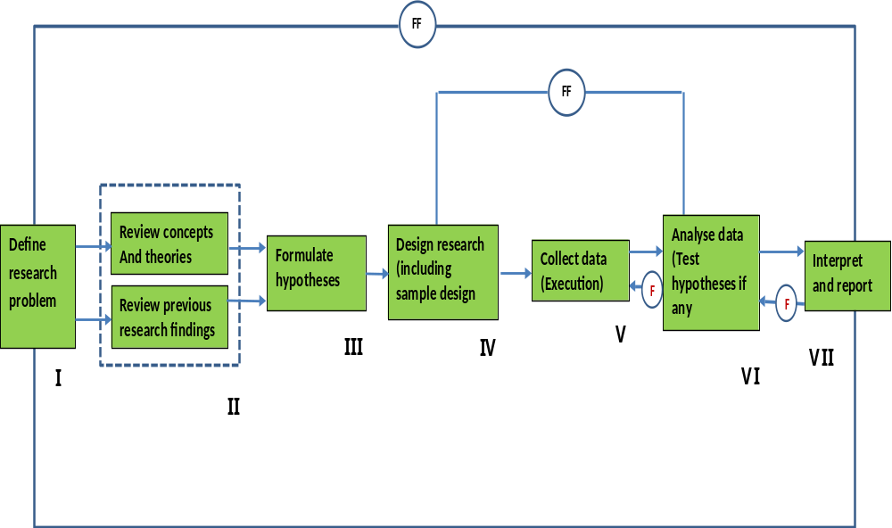
Research Process

Slide 36
Research Process
  Formulating research problem
  Extensive literature survey
  Developing the hypothesis
  Preparing the research design
  Determining sample design
  Collecting data
  Analysis of data
  Hypothesis testing
  Generalizations and interpretation
  Preparation of the research report or presentation of the research results

Slide 37
Research Process conts’
  1. Formulating research problem
  Feasibility of a particular solution has to be considered before working formulation of the problem can be set up
  The best way of understanding the problem is to discuss it with one’s colleagues or those having some expertise on the matter
  The researcher must examine all necessary literature
  The problem to be investigated must be defined unambiguously

Slide 38
Research Process conts’
  2. Extensive Literature Survey
  Once the problem has been formulated, a brief summary of it should be written down
  At this point the research should conduct extensive literature survey connected with the problem
  3. Developing of working hypotheses
  After extensive literature survey, researcher should state in clear terms the working hypothesis or hypotheses
  Hypothesis should be very specific and limited to the piece of research in hand because it has to be tested
  The role of the hypothesis is to guide the researcher and keep him on track

Slide 39
Research Process conts’
  How does one go about developing working hypotheses?
  Discussions with colleagues and experts about the problem, its origin and the objectives of seeking a solution
  Examination of data and records, if available, concerning the problem for possible trends peculiarities and other clues
  Review of similar studies in the area or of the studies on similar problems
  Exploratory personal investigation which involves original field interviews on a limited scale with interested parties and individuals with a view to secure greater insight into the problem

Slide 40
Research Process conts’
  4. Preparing the research design
  State the conceptual structure within which the research would be conducted
  The function of the research design is to provide for the collection of relevant evidence with minimal expenditure of effort, time and money
  There are several research designs such as experimental and non-experimental

Slide 41
Research Process conts’
  4. Preparing the research design
  The following should be considered when preparing the research design:
    The means of obtaining the information
    the availability and skills of the researcher and his staff
    Explanation of the way in which selected means of obtaining information will be organized and the reasoning leading to the selection
    The time available for research
    The cost factor relating to research

Slide 42
Research Process conts’
  5. Determining sample design
  The researcher must determine the way of selecting a sample (sample design)
  The are many types of sampling designs:
    Simple random sampling
    Systematic sampling
    Stratified sampling
    Quota sampling
    Cluster sampling
    Area sampling
    Multi-stage sampling
    Sequential sampling

Slide 43
Research Process conts’
  6. Collecting data
  There are several ways of collecting data which differ in the context of money, time and other resources
  Primary data can be collected either through experiment or through survey. Through a survey data can be collected by any of the following:
    By observation
    Through personal interview
    Through telephone interviews
    By mailing questionnaires
    Through schedules

Slide 44
Research Process conts’
  7. Analysis of data
  After data has been collected, analysis follows
  Raw data is classified in some purposeful and usable categories
  Coding operation is usually done at this stage through which the category of data is transformed into symbols that may be tabulated or counted
  Editing is the procedure that improves the quality of the data for coding
  With coding the stage is ready for tabulation
  Analysis work after tabulation is generally based on the computation of various percentages. Coefficients etc

Slide 45
Research Process conts’
  8. Hypothesis-testing
  After analyzing the data, the researcher tests the hypothesis
  Do the facts support the hypothesis or they happen to the contrary?
  Various tests are available: Chi square test, t-test etc
  Hypothesis testing will result in either accepting the hypothesis or in rejecting it

Slide 46
Research Process conts’
  9. Generalizations and interpretation
  If the hypothesis is tested and upheld several times, it may be possible for the researcher to arrive at generalization (i.e. build a theory)
  The real value of the research lies in its ability to arrive at certain generalizations
  If the researcher had no hypothesis to start with, he might seek to explain his findings on the basis of some theory (interpretation)
  The process of interpretation may quite trigger off new questions which in turn may lead to further researches

Slide 47
Research Process conts’
  10. Preparation of the report or the thesis
  Finally the researcher has to prepare the research report
  The layout of the report should be as follows:
    The preliminary pages
    The main text
    The end matter

